Slide 1
Unit3
Review of Literature

Slide 2
The “literature” in a literature review, refers to all the previous research and scholarship on a particular topic, no matter what discipline you are studying; the “review” is your explanation of what the literature says.
A literature review is the synthesis of the available literature regarding your research topic. This synthesis merges the conclusions of many different sources to explain the overall understanding of the topic, thus laying a foundation for both the research question and primary research.

Slide 3
A literature review will cite sources and should discuss the credibility of the sources included, it is more than an bibliography. Your literature review needs to review all the significant sources on a topic, regardless of whether or not they support the claims you will eventually be working toward. Your literature review, like any other document, should contain an introduction, a body, and a conclusion.

Slide 4
Introduction
Your introduction should clearly explain the overall research topic and the depth of the information to be presented; it often also explains the types of sources that will be used. If your literature review is part of a larger research proposal or project, its introduction can be combined with the introduction of your paper.

Slide 5
Body
The body of your literature review is intended to give your audience an overview of the already-available research on your topic. This can serve several purposes, including:
llustrating the importance of a particular problem in a field
Identifying a gap in the knowledge of a particular subject
Defining key terms and ideas that are used in a particular field
Explaining research methods commonly used in a discipline
Identifying potential problems with possible research methods
Directing the reader toward the research question

Slide 6
1.The claim needs to tie into the overall purpose that the literature review is made.
2. The evidence needs to be properly cited information from reliable sources that are relevant to the topic and consists of the information given within the sources that you are reviewing.
3. The discussion needs to show how the sources support the specific claim being made. The discussion should also put the information into a context that reflects your intended purpose.

Slide 7
Coherent structure is important. The general information needs to work toward some overall framework. Outlining the sources that you will present can help to provide a structure that will direct your audience toward the research topic.

Slide 8
Conclusion Depending on the purpose(s) of your literature review, your conclusion may include the following:
1. Introduction to further research: The conclusion of your literature review can be used to explain your intended research question.
2. Summary of theories: Your conclusion can summarize central theories and ideas that give your reader a better understanding of the topic.
3. Discussion of the gap: If your literature review has revealed a gap in general understanding, your conclusion can explain the significance of that gap.

Slide 9
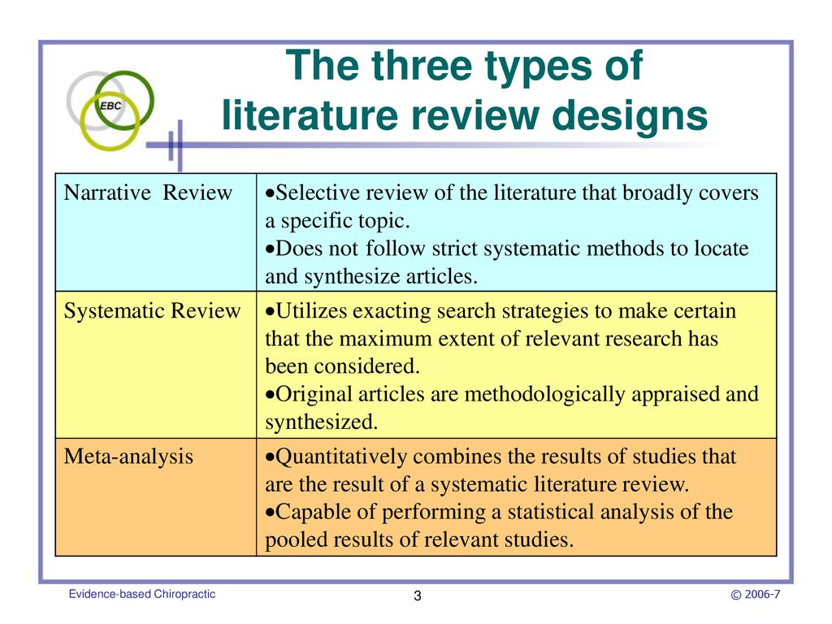

Slide 10
There are many different types of literature reviews, each with its own approach, analysis, and purpose. The following are some of the more common types of literature reviews.
The Systematic Review is important to health care and medical trials, and other subjects where methodology and data are important. Through rigorous review and analysis of literature that meets a specific criteria, the systematic review identifies and compares answers to health care related questions. The systematic review may include meta-analysis and meta-synthesis.
The Quantitative or Qualitative Meta-analysis Review can both make up the whole or part of systematic review(s). Both are thorough and comprehensive in condensing and making sense of a large body of research. The quantitative meta-analysis reviews quantitative research, is objective, and includes statistical analysis. The qualitative meta-analysis reviews qualitative research, is subjective (or evaluative, or interpretive), and identifies new themes or concepts.

Slide 11
Narrative Review often appears as a chapter in a thesis or dissertation. It describes what related research has already been conducted, how it informs the thesis, and how the thesis fits into the research in the field.
The Critical Review is like a literature review, but requires a more detailed examination of the literature, in order to compare and evaluate a number of perspectives.
The Scoping Review is often used at the beginning of an article, dissertation or research proposal. It is conducted before the research begins, and sets the stage for this research by highlighting gaps in the literature, and explaining the need for the research about to be conducted, which is presented in the remainder of the article.

Slide 12
The Conceptual Review guided by an understanding of basic issues rather than a research methodology, the writer of a conceptual literature review is looking for key factors, concepts or variables and the presumed relationship between them. The goal of the conceptual literature review is to categorize and describe concepts relevant to the study or topic and outline a relationship between them, including relevant theory and empirical research.
Example: Education policy, The formality of learning science in everyday life.
The State-of-the-Art Review is conducted periodically, with a focus on the most recent research. It describes what is currently known, understood, or agreed upon regarding the research topic, and highlights where are there still disagreements.
considers mainly the most current research in a given area or concerning a given topic

Slide 13
Exploratory The purpose of an exploratory review is to provide a broad approach to the topic area. The aim is breadth rather than depth and to get a general feel for the size of the topic area. A graduate student might do an exploratory review of the literature before beginning a more comprehensive one.
e.g. University research management, An exploratory review of design principles in constructivist gaming learning environments.
Empirical
An empirical literature review collects, creates, arranges, and analyzes numeric data reflecting the frequency of themes, topics, authors and/or methods found in existing literature. Empirical literature reviews present their summaries in quantifiable terms using descriptive and inferential statistics. Examples of an Empirical Review: Impediments of e-learning adoption in higher learning institutions of Tanzania: An empirical review

Slide 14
Is this plagiarism?
Original source In order to communicate effectively with other people, one must have a reasonably accurate idea of what they do and do not know that is pertinent to the communication. Treating people as though they have knowledge that they do not have can result in miscommunication and perhaps embarrassment.
Nickerson, R. S. (1999). How we know - and sometimes misjudge – what others know: Imputing one's own knowledge to others. Psychological Bulletin,125(6), 737-759.
Student’s own work Effective communication depends on a generally accurate knowledge of what the audience knows. If a speaker assumes too much knowledge about the subject, the audience will either misunderstand or be bewildered.

Slide 15
Yes, this is plagiarism. Although the student paraphrased from the original source, a citation must be provided in text and a reference at the end of their assignment. e.g. ...or be bewildered (Nickerson, 1999).

Slide 16
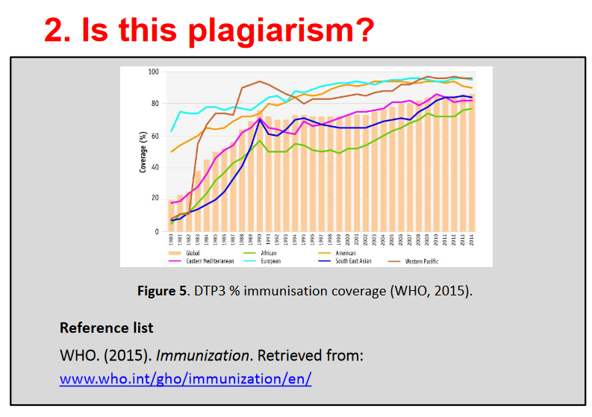

Slide 17
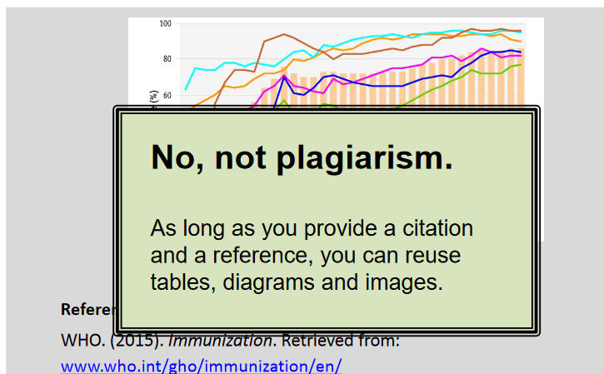

Slide 18
Article1 Sometimes we have to write long papers to treat a topic adequately, but much of the time, it’s unnecessary: Papers often contain long introductions more suitable for doctoral dissertations, apparently intended to provide evidence that the author is well-read...
Krashen, S. (2013). Reading and vocabulary acquisition: Supporting Evidence and some objections. Iranian Journal of Language Teaching Research, 1(1), 27-43.
Article 2 Sometimes we have to write long papers, but most of the time, it is unnecessary: the papers often contain long introductions more suitable for doctoral dissertations or review “state of the art” papers apparently designed to provide evidence that the author is well-read.
Krashen, S. (2012). A short paper proposing that we need to write shorter papers. Language and Language Teaching, 1(2), 38-39.

Slide 19
Yes, this is self-plagiarism.
Even your own previously submitted work must be cited and referenced appropriately. You could either quote, paraphrase or summarise, providing a citation to the original source.

Slide 20
What is plagiarism?
Plagiarism is defined as presenting someone else’s work as your own by:
• Cutting and pasting from other sources • Quoting without “...” or a citation • Paraphrasing or summarizing without a citation • Using images, tables or graphs without a citation • Re-using own work which was previously marked • Collaborating on what should be individual work forgetting to cite is still plagiarism.

Slide 21
What are citing & referencing?
Citing • when you quote, paraphrase, use an idea, or summaries from someone else • gives the reader the original source
Referencing
• creating a list of sources you have cited • different from a bibliography, which also includes sources you read but did not use directly in writing your text

Slide 22
Citing demonstrates that you...
• gathered evidence to support your ideas and arguments • used credible, good quality sources • read widely and at an appropriate academic level • allows your marker to differentiate between your own work and the work of others, and to locate your sources.

Slide 23
When and what to cite……..
Within & at the end of the text when you use ideas from, or refer to, another person’s work.
Applies to: facts, figures, ideas & theories From: books, journals, internet, videos, lecture notes etc.
Exception: common knowledge

Slide 24
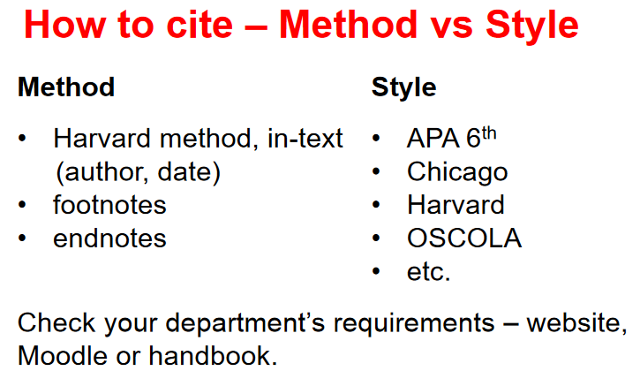

Slide 25
American Psychological Association”
can be abbreviated to “APA.”

Slide 26
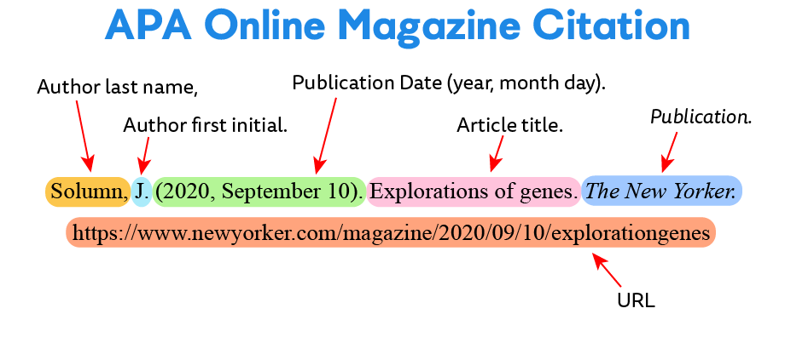

Slide 27
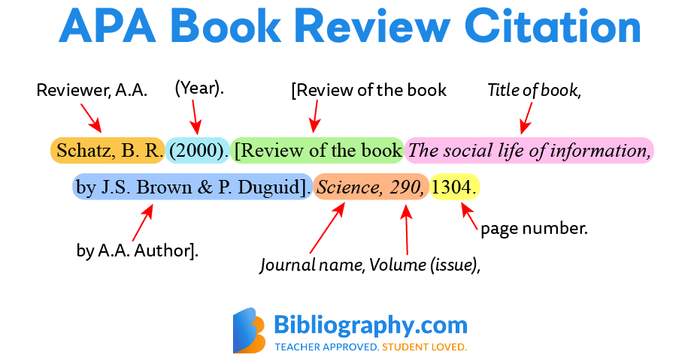

Slide 28
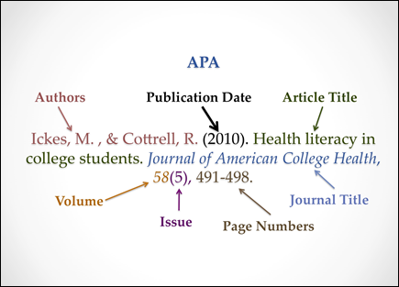

Slide 29
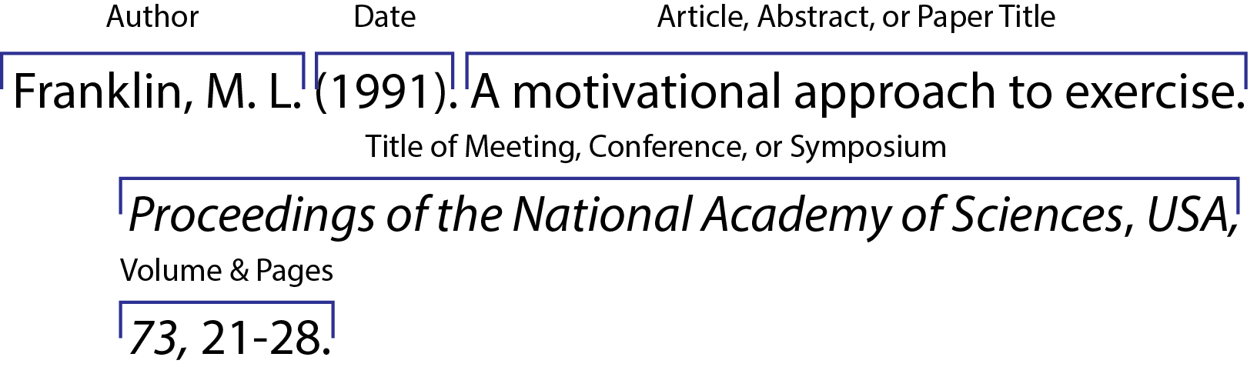

Slide 30
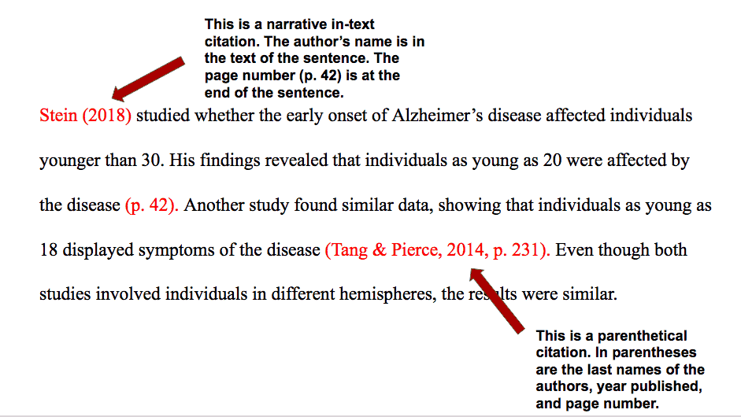

Slide 31
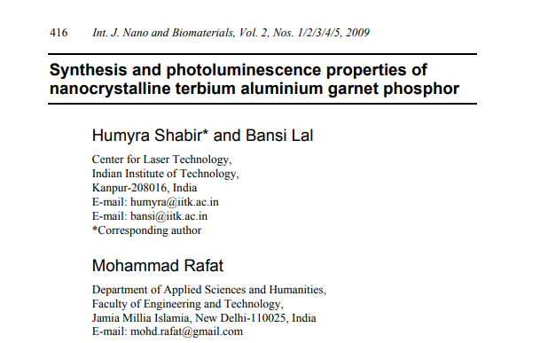
Write APA style

Slide 32
A social networking site is an online place where a user can create a profile and build a personal network that connects him or her to other users. In the past five years, such sites¹ have rocketed from a niche activity into a phenomenon that engages tens of millions of internet users. The explosive growth in the popularity of these sites has generated concerns among some parents, school officials, and government leaders about the potential risks posed to young people when personal information is made available in such a public setting.
The survey, conducted by telephone from October 23 through November 19, 2006 among a national sample of 935 youths ages 12 to 17, asked about the ways that teenagers use these sites and their reasons for doing so.

Slide 33
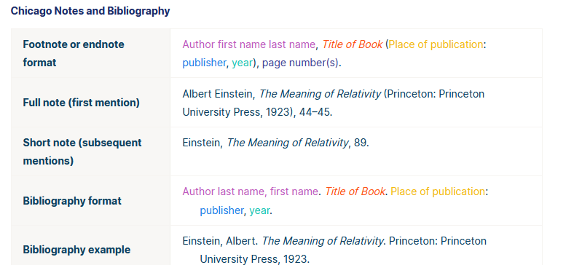
Chicago book citation

Slide 34
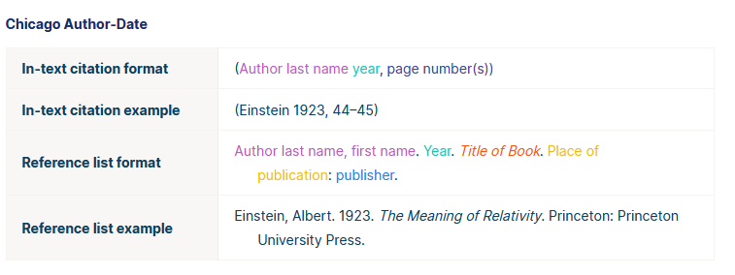

Slide 35
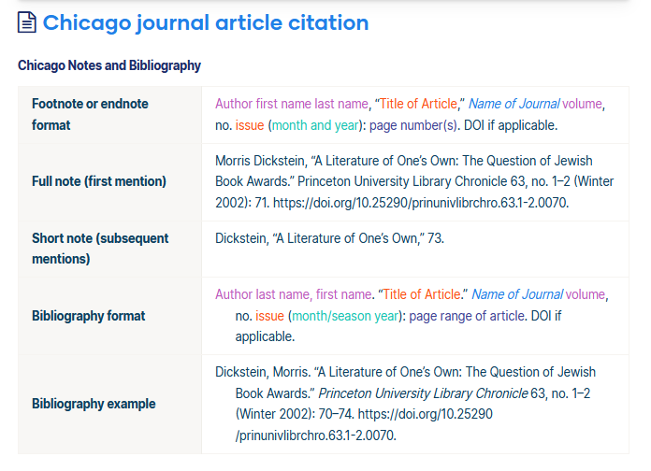

Slide 36
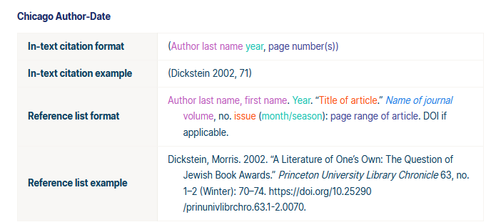

Slide 37
Write Chicago style

Slide 38


Slide 39


Slide 40


